Slide 1
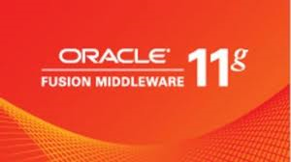
Oracle Fusion Middleware 11g (OFM) Overview

Slide 2
What is Middleware
Middleware is the software that connects software components or enterprise applications
Middleware is the software layer that lies between the operating system and the applications on each side of a distributed computer network
Middleware is the infrastructure which facilitates creation of business applications, and provides core services like concurrency, transactions, threading, messaging, security, high availability
It is similar to the middle layer of a three-tier single system architecture, except that it is stretched across multiple systems or applications and supports complex, distributed business software applications.

Slide 3
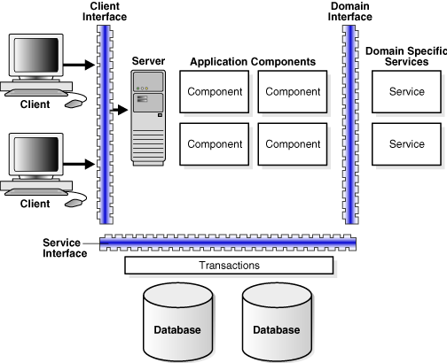
Middleware Architecture

Slide 4
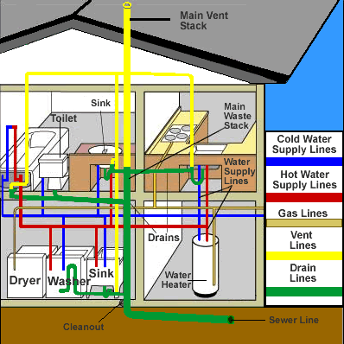
House Plumbing System

Slide 5
House Plumbing System
Mostly invisible and hidden
Provides standard way of doing things
It ties together parts of complex system
It lets you worry about other things

Slide 6
Middleware
Hides
Distributed nature of applications
Enterprise heterogeneity (Hardware, OS, Communication protocols)
Low level programming details
Provides uniform, standard, high-level interfaces to the application developers and integrators, so that applications can be easily composed, reused, ported, and made to interoperate
Supplies a set of common services to perform various general purpose functions to avoid duplicating efforts, and to facilitate collaboration between applications
Makes application development easier

Slide 7
Middleware System Design Challenges
Performance
Middleware systems rely on interception and indirection mechanisms, which induce performance penalties.
Scalability
As applications become more and more interconnected and interdependent, the number of objects, users, and devices tends to increase.
Management
Managing large applications that are heterogeneous, widely distributed, and in permanent evolution
The availability, reliability, concurrency, security, and performance of applications may also be an issue.

Slide 8
Oracle Fusion Middleware (OFW) 11g
It’s a massive rebranding of
Oracle homegrown and
Acquired products

Slide 9
Oracle Strategic Acquisitions: DATABASE
DataScaler (October 2010)
e-Test (acquired from Empirix) (March 2008)
Innobase (October 2005)
Moniforce (December 2007)
mValent (February 2009)
Secerno (May 2010)
Sleepycat (February 2006)
TimesTen (June 2005)
TripleHop (June 2005)

Slide 10
MIDDLEWARE
AmberPoint (February 2010)
BEA (January 2008)
Bharosa (July 2007)
Bridgestream (September 2007)
Captovation (January 2008)
ClearApp (September 2008)
Context Media (July 2005)
Datanomic (April 2011)
HyperRoll (September 2009)
GoldenGate (July 2009)
Java (April 2009)
Oblix (March 2005)
OctetString (November 2005)
Passlogix (October 2010)
Sigma Dynamics (August 2006)
Silver Creek Systems (January 2010)
Stellent (November 2006)
Sunopsis (October 2006)
Tacit Software (November 2008)
Tangosol (March 2007)
Thor Technologies (November 2005)

Slide 11
APPLICATIONS
AppForge (April 2007)
Haley (October 2008)
Interlace Systems (October 2007)
LogicalApps (October 2007)
Market2Lead (May 2010)
Ndevr (February 2011)
TempoSoft (December 2005)

Slide 12
Product Lines
Agile (May 2007)
ATG (November 2010)
Hyperion (March 2007)
PeopleSoft (January 2005)
Primavera (October 2008)
Siebel (January 2006)
Telephony@Work (June 2006)

Slide 13
SERVER AND STORAGE SYSTEMS
SERVER AND STORAGE SYSTEMS
Sun (April 2009)
Virtual Iron (May 2009)
Implementation and Integration Tools
Global Knowledge Software (GKS) (July 2008)

Slide 14
INDUSTRY SOLUTIONS
Communications and Media
Convergin (February 2010)
eServGlobal's Universal Service Platform (USP) (May 2010)
HotSip (February 2006)
MetaSolv Software (October 2006)
Net4Call (April 2006)
Netsure Telecom Limited (September 2007)
Portal Software (April 2006)
Sophoi (October 2009)
Engineering and Construction
Primavera (October 2008)
Financial Services
i-flex (August 2005)
Health Sciences
Phase Forward (April 2010)
Relsys (March 2009)
Industrial Manufacturing
Agile (May 2007)
Conformia Software (June 2009)
Demantra (June 2006)
G-Log (September 2005)
Insurance
AdminServer (May 2008)
Skywire Software (June 2008)
Retail
360Commerce (January 2006)
Advanced Visual Technology (AVT) (October 2008)
ProfitLogic (July 2005)
Retek (April 2005)
Utilities
LODESTAR (April 2007)
SPL WorldGroup (November 2006)

Slide 15
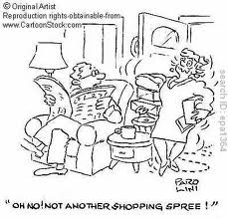

Slide 16
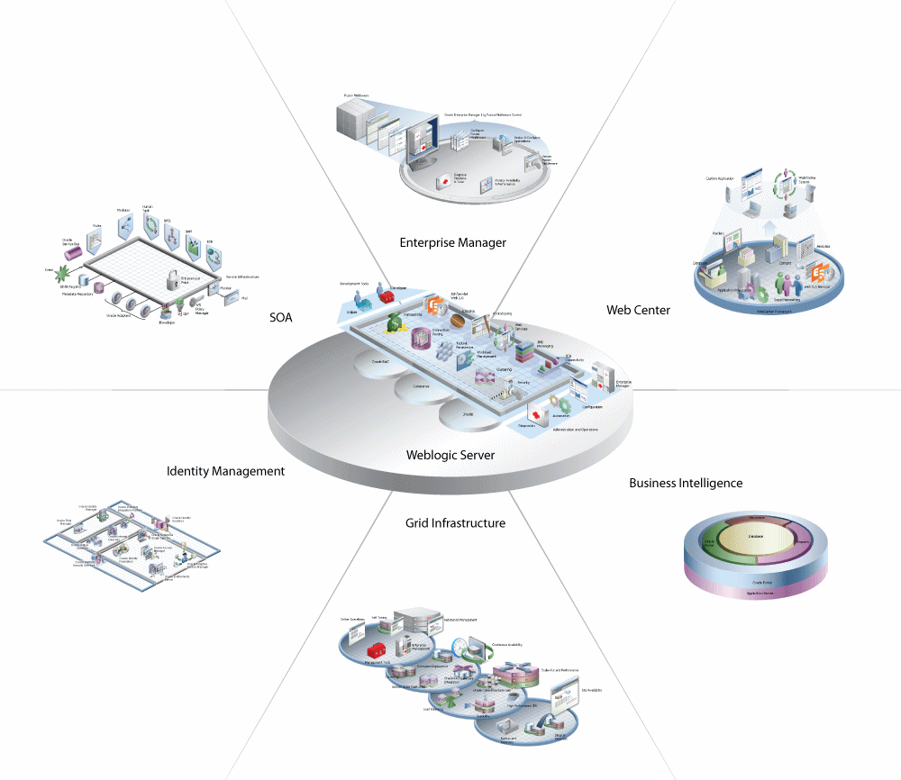
Oracle Fusion Middleware Solution

Slide 17
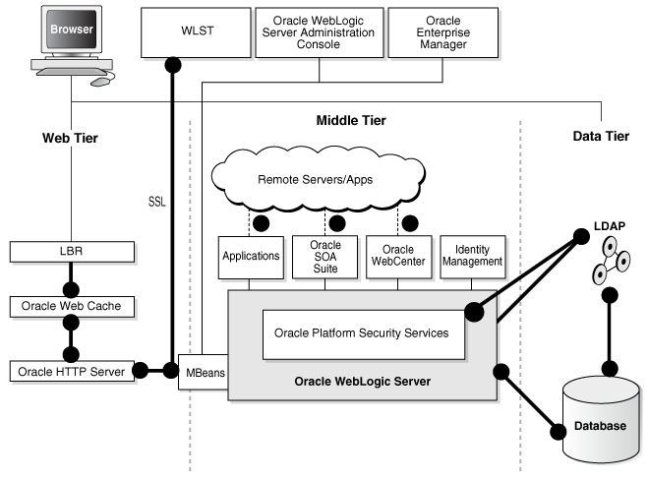
Oracle Fusion Middleware Architecture Overview

Slide 18
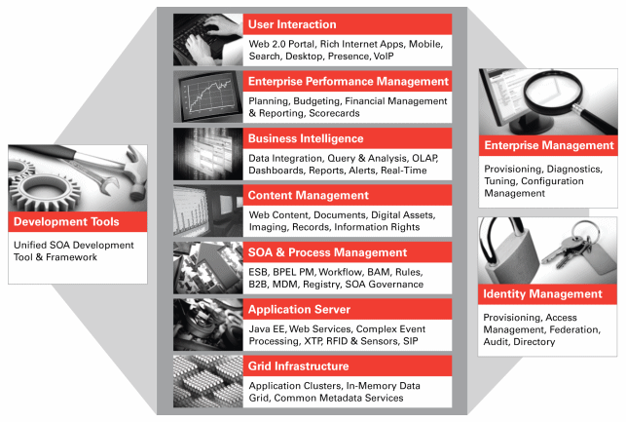
Overview of the Oracle Fusion Middleware Solution

Slide 19
Integration & Process Management
Application Integration Architecture (AIA) Foundation Pack
Enterprise Repository
BPEL Process Manager
Event Driven Architecture
Business Activity Monitoring
GoldenGate
Business Rules
RFID and Sensor Edge Server
Business Process Analysis Suite
Service Bus
Business Process Management
Service Registry
Business-to-Business Integrations
SOA Governance
Complex Event Processing
SOA Suite
Data Integrator
Web Services Manager
Enterprise Connectivity (Adapters)
WebLogic Integration
Enterprise Messaging Service
Oracle Data Integration

Slide 20
Development Tools
Enterprise Performance Management
Application Development Framework
Mapviewer
Developer Suite
User Productivity Kit
Enterprise Pack for Eclipse
Virtual Assembly Builder
Forms Services
Workshop
JDeveloper
Performance Management Applications
Hyperion Planning
Hyperion Performance Scorecard
Hyperion Capital Asset Planning
Hyperion Workforce Planning
Hyperion Strategic Finance
Hyperion Financial Management
Hyperion Profitability and Cost Management

Slide 21
Business Intelligence
Systems Management
Business Activity Monitoring
Data Integrator
Business Intelligence
Essbase Plus
BI Publisher
GoldenGate
Crystal Ball
Reports Services
Oracle Data Integration
Enterprise Manager 11g
Web Services Manager

Slide 22
Identity Management
Single Sign-On and Web Access Control
Oracle Access Manager
Oracle Identity Federation
Oracle Enterprise Single Sign-On Suite Plus
Oracle Security Token Service
Directory Services
Oracle Internet Directory
Oracle Virtual Directory
Oracle Directory Server Enterprise Edition
Oracle Authentication Services for Operating Systems
Content Access Control
Oracle Information Rights Management
Strong Authentication
Extended Identity Management Ecosystem
Oracle Adaptive Access Manager
Identity Administration
Oracle Identity Manager
Oracle Role Manager
Web Services Security
Oracle Web Services Manager
Oracle Enterprise Gateway
Identity and Access Governance
Oracle Identity Analytics
Security Toolkits
Oracle Security Developer Tools
Federated Identity
Oracle Identity Federation
Fine Grained Entitlements
Oracle Entitlements Server
Fraud Detection
Oracle Adaptive Access Manager
Oracle - Sun
Oracle Waveset
Oracle OpenSSO

Slide 23
User Interaction & Content Management
Others
Beehive
WebCenter Suite
Enterprise Content Management
WebCenter IC
Application Server Portal
WebCenter RTC
Microsoft Office Interoperability
WebLogic Portal
Communications Platform
Communications Converged Application Server
Communications Presence
High Availability
Upgrade
Oracle Fusion Middleware Upgrade

Slide 24
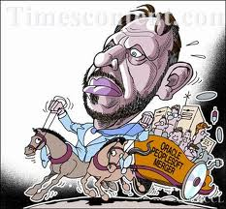
Jump on the Wagon

